Slide 1
Dream Housing Finance
Loan Eligibility Data Set

Slide 2
Problem Statement
The company wants to automate the loan eligibility process based on the details provided by their customers while filling out the online application form. The details provided by the forms were:
Gender
Marital Status
Education
Number of dependents
Income
Loan Amount
Credit History

Slide 3
Opening stats:
Loan Train (614)
Majority Values:
male = 80% (491)
female = 18% (110)
other = 2% (13)
married = 65% (398)
unmarried = 35% (213)
null = 0% ( 3 )
graduate = 78% (479)
Non-graduate= 22% (135)
(Loan) yes = 100% (614)
no = 0% ( 0 )
Majority of the sample were married men, who have graduated from education
All of them have an approved loan status
The majority property area owned by the applicants are in urban areas or semi-urban areas
Majority of the unique values have a credit history of 1 and the loan amount terms is mostly 360 months = 30 years

Slide 4
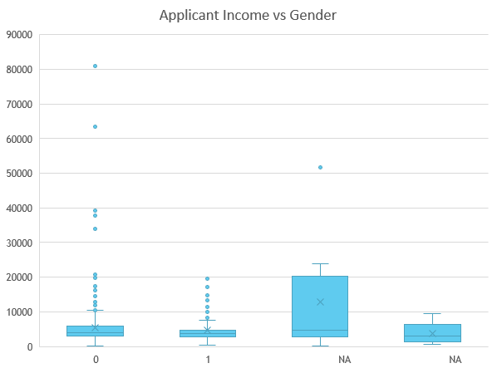
Applicant Income vs Gender
Column1 | Column2
Applicant Income
Mean | 5403.459283
Standard Error | 246.5408575
Median | 3812.5
Mode | 2500
Standard Deviation | 6109.041673
Sample Variance | 37320390.17
Kurtosis | 60.54067593
Skewness | 6.539513114
Range | 80850
Minimum | 150
Maximum | 81000
Sum | 3317724
Count | 614
80% of the client database from the data set were men and majority of the outliers on the boxplot above, show that majority of the outliers came from male applicants.
18% of the applicants were females but they didn’t earn over 20,000 unlike their male applicants.
2% of the applicants (13) did not list their gender but they also did not earn over 20,000.

Slide 5
Similarities and Comparisons within the Data:

Slide 6
Suggestions for DHF
Before automating their loan eligibility process, I would suggest that DHF think about streamlining their applicants. From looking at the graph, it shows that 100% of applicants had an approved loan status. Where 7 means “yes” and 8 means “no”
Even though all applicants had an approved loan status, not all of them had a credit history of 1. Some had a history of 0 or did not even fill in that section of the application.
Also, when looking at the dataset, around 5% of applicant’s did not provide an answer when asked if they were self-employed or not.

